Slide 1
Bringing Greetings to Michigan!

Slide 2
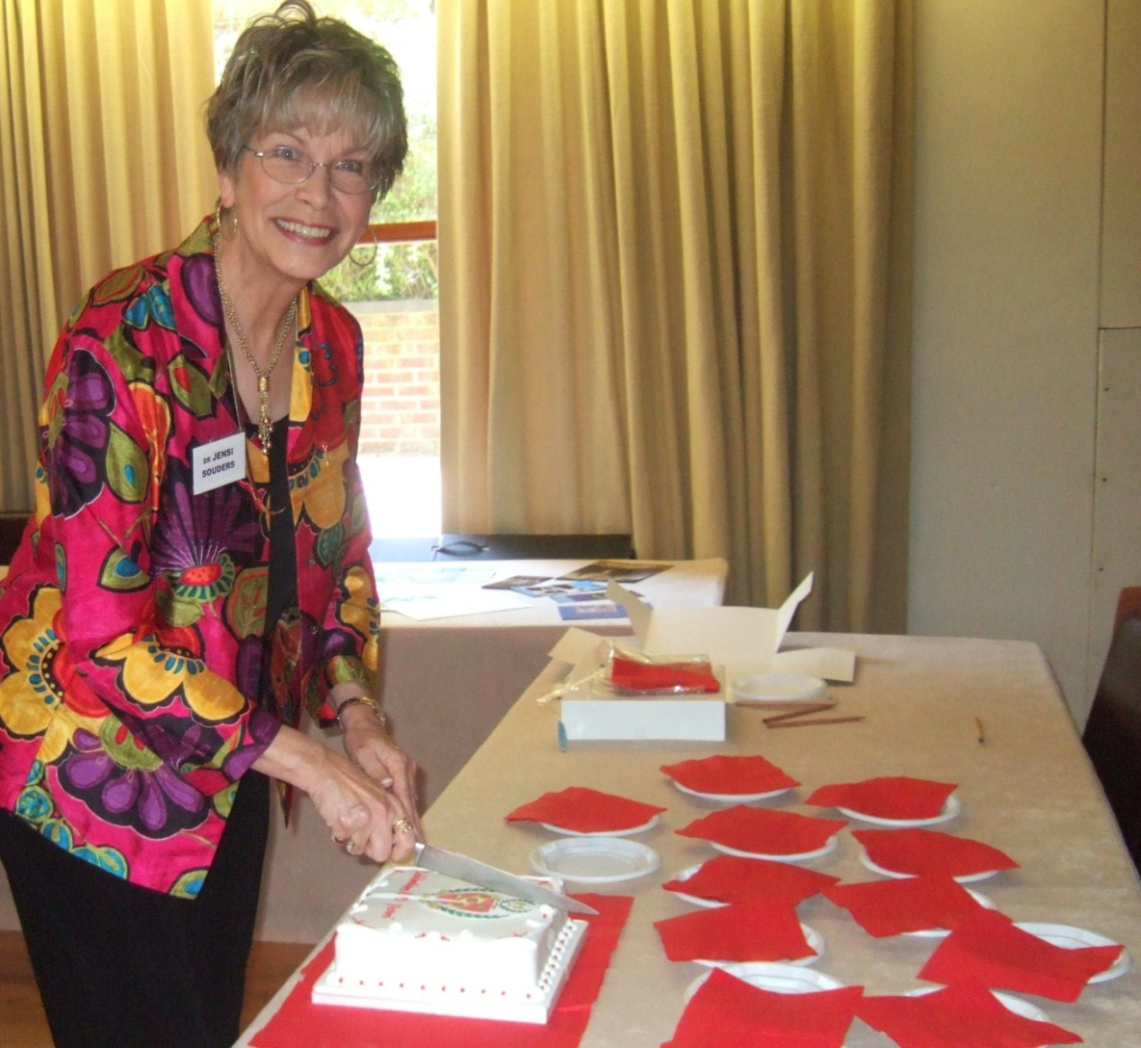
Greetings from Jensi Souders
DKG International President

Slide 3
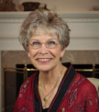
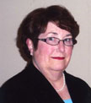
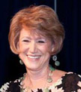
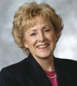
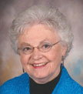
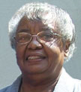
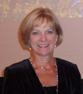
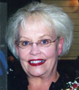
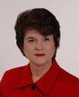
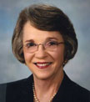
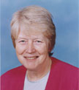
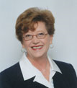
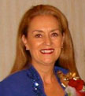
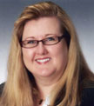
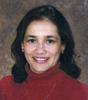
The Administrative Board

Slide 4
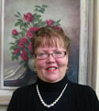
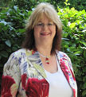
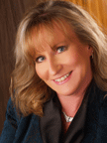
Headquarters Staff
<Corlea Plowman – Executive Director
<Phyllis Hickey – Operation Services
Administrator
Linda Eller – Information Services
Administrator>
<Nita Scott – Membership Services
Administrator

Slide 5
Facts and Figures about DKG
    Over 90,000 members
      2,700 chapters
        79 state organisations
          17 member countries

Slide 6
DKG MICHIGAN- How are you?
Your State Officers
State President – Olive Lane Horning
Executive Secretary – Sally Garrison
State Editor – J-Jay Pechta
State Treasurer – Loretta Miles
State Webmaster – Tamara Webster

Slide 7
Your International Personnel
Dr Paula Dent – PIP 1996-1998
- International Achievement Award 1999
Dr Helen Popovich – Chair, Educational
Excellence Committee
J-Jay Pechta – International Communicatios
Committee; Educational
Foundation Liaison
Notes:
I hope there is encouraging news about her health?

Slide 8
You have 63 chapters and approximately 1916 members.
Since 1983, members from Michigan have received $71,750 in DKG Scholarships, most recently Krista Hall in 2006-10. Keep the applications
coming!
Last year Jacqulyn Smart received a $1,000 award from the Cornetet Professional Development fund.
Notes:
Wold and national economic downturn has had a big impact on Michigan membership – especially regarding the motor industry and all others linked to it.

Slide 9
2 Michigan members received Educational Foundation funding for Renewed Projects 2012-13:
Judi Fisher from Northville for The Rose Project
and Carole Speidel from Sandusky for the Read
To Me project in Sanilac County.
World Fellowships in Michigan had been awarded to 19 women by 2011, totalling $64,900*.
11 members from Michigan have been to the Leadership/Management seminar in Texas, worth $6,000 each.* Who will be next?
2 of your members have been awarded Golden Gift Stipends.
Notes:
In 1967, Sigrun Klara Hannesdottir from Iceland came to Wayne State University to study Library Science. She went on to be State President, Regional Director, and the First European to become 2nd International Vice President.
Your State President, Olive Horning went to GG in 2008, but not as a Michigan member!
Dr Helen Popovich was one of the first from Michigan in 1980, along with Dr Betty Brogan and Dr Lois Holland, then I saw that Dr Paula Dent went in 1981.

Slide 10
Theme for 2010-2012
Embracing Our Vision · Designing Our Future
Members and chapters know that everything they do for:
students,
teachers,
early-career educators,
women and children………….

Slide 11
………makes an impact on our DKG vision,
Leading Women Educators Impacting Education Worldwide.

Slide 12
The impact we make collectively, through focused and united efforts, means that we are designing our future by contributing to educational success via the projects we are working on at chapter, state and international levels.

Slide 13
Strengthening DKG at Chapter Level
The recent training of state organisation leaders emphasised chapter strengthening.
Educational Focus days at all regional conferences made an impact by presenting global contexts.
A new nomination process for international officers means that all members can be involved in deciding how the votes for each state are cast*.
Notes:
This year, each State will cast votes to decide between the 2 nominees for 1st Vice President. We are nearly becoming democratic.

Slide 14
Strengthening DKG at Chapter Level
New resources produced include:
  New materials for introducing what DKG is all about
  Revised and updated ideas for ceremonies
  A brand new handbook for chapters and members, GoTo Guide now available
  Revised Guidelines booklets
  Models for providing leadership training available to all members by July
Notes:
DKG publications are attractive - they look, and are, professional:
Newsletters (July/August online)
The Bulletin (2 in hard copy, 2 online)
Brochures – You and Us, One and All

Slide 15
Strengthening DKG at Chapter Level
New resources continued:
  Outline plans for chapter programmes and activities
  Regular information in newsletters about our international project, Schools for Africa
  Latest donation total: $70,804.16
  Resources and ideas for supporting educators at the start of their careers
  Strategic Action Plan training for states and chapters

Slide 16
Strengthening DKG at Chapter Level
More new resources:
  Great strides in technology, with the DKG Network, weekly updating of the international website, use of Go to Meeting software for electronic meetings, the study of electronic elections, and a consistent, professional style for all our publications.

Slide 17
A Personal Message from the International President
I hope that you have made your plans to attend our international convention in New York City, July 24-28. It is a truly ‘destination event’, a once-in-a-lifetime experience.
Workshop sessions will follow four strands:
Professional Practices,
Educational Excellence,
DKG and the Future,
and Personal/Cultural Enrichment.

Slide 18
The schedule has been planned that will allow you time on your own to enjoy what attracts you, whether it is sightseeing, shopping, museum browsing, or theatrical performances. Join us in a great city of the world, at a site that is within walking distance of Times Square, Central Park, the Rockefeller Centre, Broadway, and many other places in between.
We are building excitement and enjoyment that is contagious. We hear stories of greater camerarderie

Slide 19
and cohesiveness among members and chapters that let us know that we are well on our way to a successful future. All of us embrace a shared vision to make an impact on education through local, community efforts. Thank you for helping DKG to meet the needs of education in the 21st century, for helping us to design a future that will benefit us all.
Jensi Souders

Slide 20

2012 International Convention
Sheraton Hotel and Towers, NY
24-28 July
2013 Northeast Regional Conference
Portland, Maine
24-27 July

Slide 21
You must go on the tours!

Slide 22
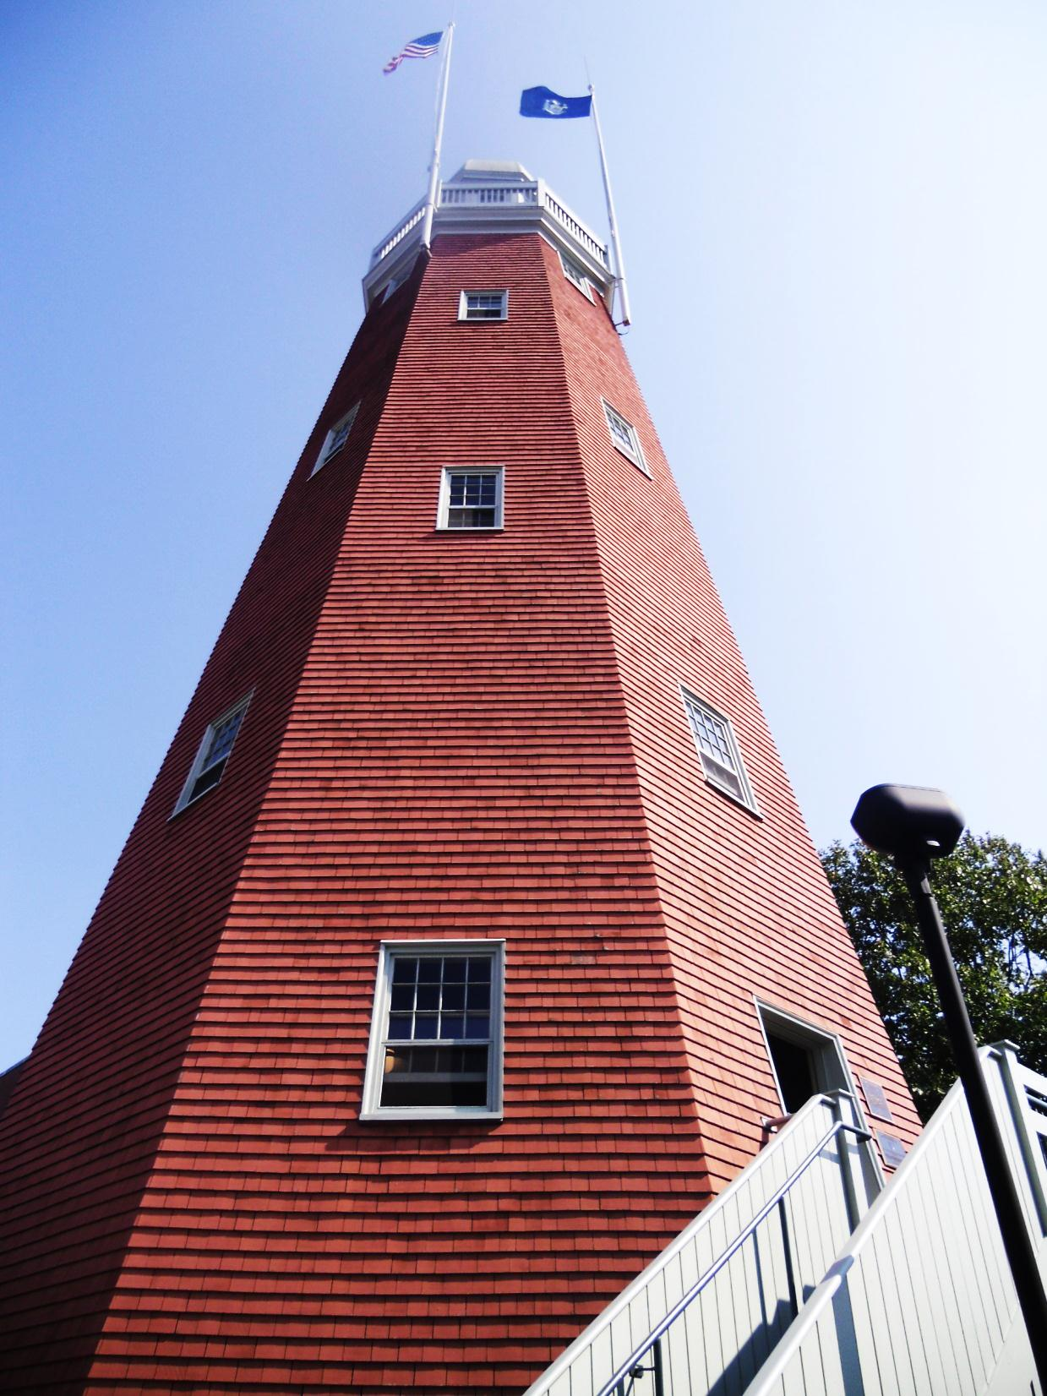
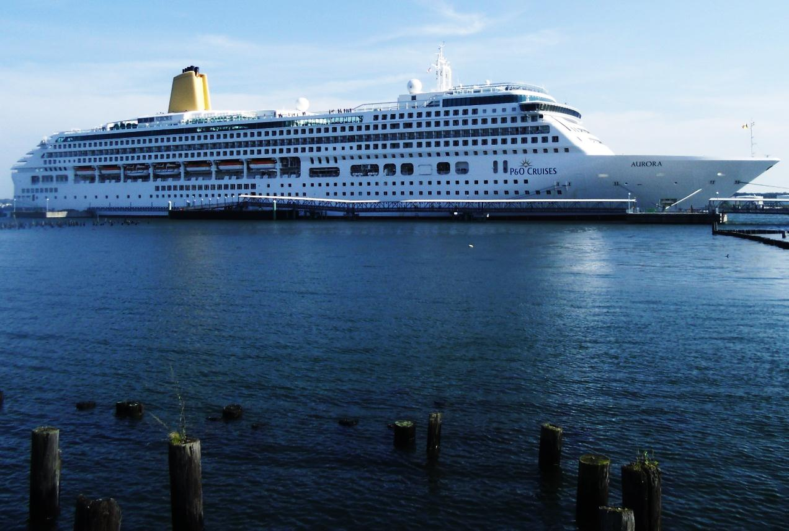

Slide 23
